Slide 1
IoT Solution: Prove Me
Name: Zhang Haorui
Admin: 2101806D

Slide 2

Background
Lack of automation found in the supermarket industry, especially the checkout experience.
Alcohol/Tobacco check still requires manual staff identity check.
For customers using self-checkout, it defeats the purpose of self-service.
If there is high customer demand, the waiting time to conduct manual identity checks will be longer.
Results in customers having a poor checkout experience.
Frustrations among shoppers.
Prove Me aims to:
Reduce waiting times at checkouts
Reduce frustrations among shoppers
Reduce manpower involved in identity checks

Slide 3
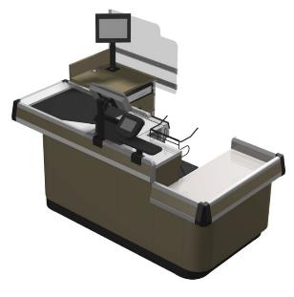
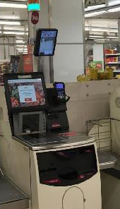
Targeted Users
Retail Shops (Retail Industry)
Alcohol/Tobacco retailers
Supermarkets
Stores with LOW manpower but HIGH customer demand
Prove Me can be installed at both manual and self-checkout counters.
Camera Sensor & Price Display
Camera Sensor

Slide 4
Features
Add/Delete taken a photo from an S3 bucket before and after age verification.
Able to retrieve 2 photos from S3 to compare and recognise a famous person’s identity through the Rekognition function.
Store the following details in AWS DynamoDB if the user purchases alcohol/tobacco, and is above 18/21 years old:
Transaction ID,
Time,
Number of Alcohol/Tobacco purchased,
Device ID,
Name, NRIC, Age,
Confidence Level
TTL Value (Time of deletion of the data row)
Auto-delete of data in DyanamoDB after 1 year through the Time-to-Live (TTL) function.
Implementing age restrictions on alcohol/tobacco products through Lambda codes
Logging cloud services’ performance through CloudWatch to ensure smooth sailing of all services.
Providing on-demand notifications on the result of ProveMe after transacting age-restricted products through the Simple Notification Service

Slide 5
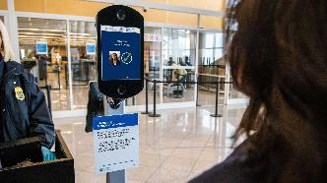
Existing Products
Singpass Face Authentication (2FA)
No need to find/grab for the registered mobile device to check SMS OTP
Requires only the user’s face, which is already present for verification (Convenience)
Reduction in waiting times of over 10 minutes when using the face scan feature to reset passwords (Singpass)
More than 3200 users have accessed Government service at kiosks through face verification (Singpass)
Face Verification at Airport Customs
Reduces human error and waiting times → Preventing exploitations
Requires fewer personnel involved in boarding gates → Automation and cut costs
High efficiency and smooth process in boarding flow among passenger
Automated face verification takes 2 to 3 seconds in customs.
Manual verification takes 10 to 30 seconds in customs.
(U.S. Customs and Border Protection)
90% FASTER

Slide 6
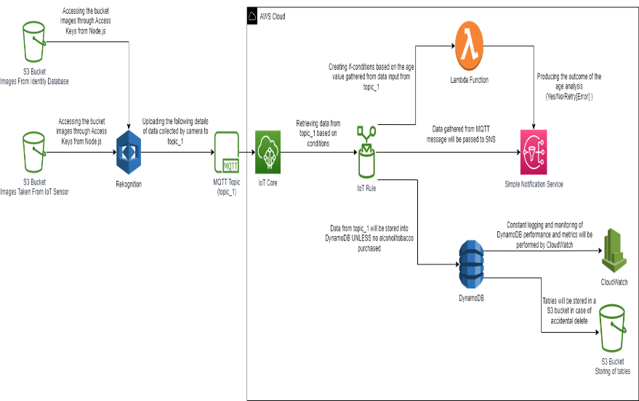
System Architecture

Slide 7
Assumptions
Uploading a taken photo to an S3 bucket (photo taken) will simulate the photo taken by a camera.
Assume that only famous celebrities are in the identity database.
The ID provided by Rekognition on the celebrity will be presumed as NRIC.
Number of Alcohol/Tobacco purchased will be simulated as Point-of-Sales (POS) systems are not available.

Slide 8

Limitations
Not being able to get the actual identity of the person through an actual identity database.
Require an actual identity database from the Government
New staff members may not be familiar with Prove Me.
Constant training will be needed to train the new staff if faced errors.
Reluctance from customers (users)
Privacy and security
Able to work with Government Agencies and enable more restrictions in AWS (Roles/S3 Access)
Unfamiliar with the positioning/clarity of the face
AWS Learner Lab is highly restricted due to security and administrative reasons.
To fix the above issue, a personal AWS account is used.

Slide 9
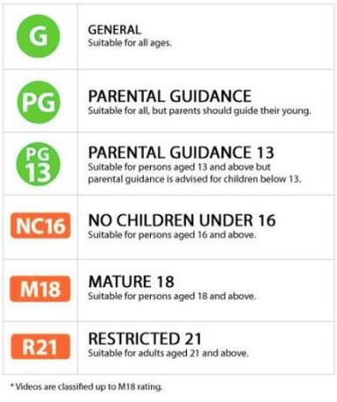
Future Enhancement
Work with the Immigration & Checkpoints Authority to implement a secure and informational facial recognition technology.
Able to gather from the database different attributes:
Name
NRIC
Actual Age
Date of birth
Test run on supermarkets with self-checkout technology AND with high customer flow.
Further implemented in other sectors.
E.g. Implementing ProveMe in cinemas to prevent minors from viewing age-restricted movies.

Slide 10
Challenges / Lessons Learnt
Implementing and learning AWS Rekognition SDK through Visual Studio Code.
Used the following functions provided by Rekognition:
Compare Faces, Recognize Celebrities and Detect Faces
Connecting an S3 Bucket to Rekognition through access keys and region.
Access keys are a method for SDK to access an AWS account and utilise the AWS services.
No need to set S3 Bucket for public access in this case.
Implementing and learning the use of the Time-to-Live feature on DynamoDB.
AWS Learner Lab is very restrictive to different AWS services.
Though it is possible to implement restricted services through Lambda, a personal AWS account provides customisation and flexibility to developers.

Slide 11
Thank You

